Slide 1

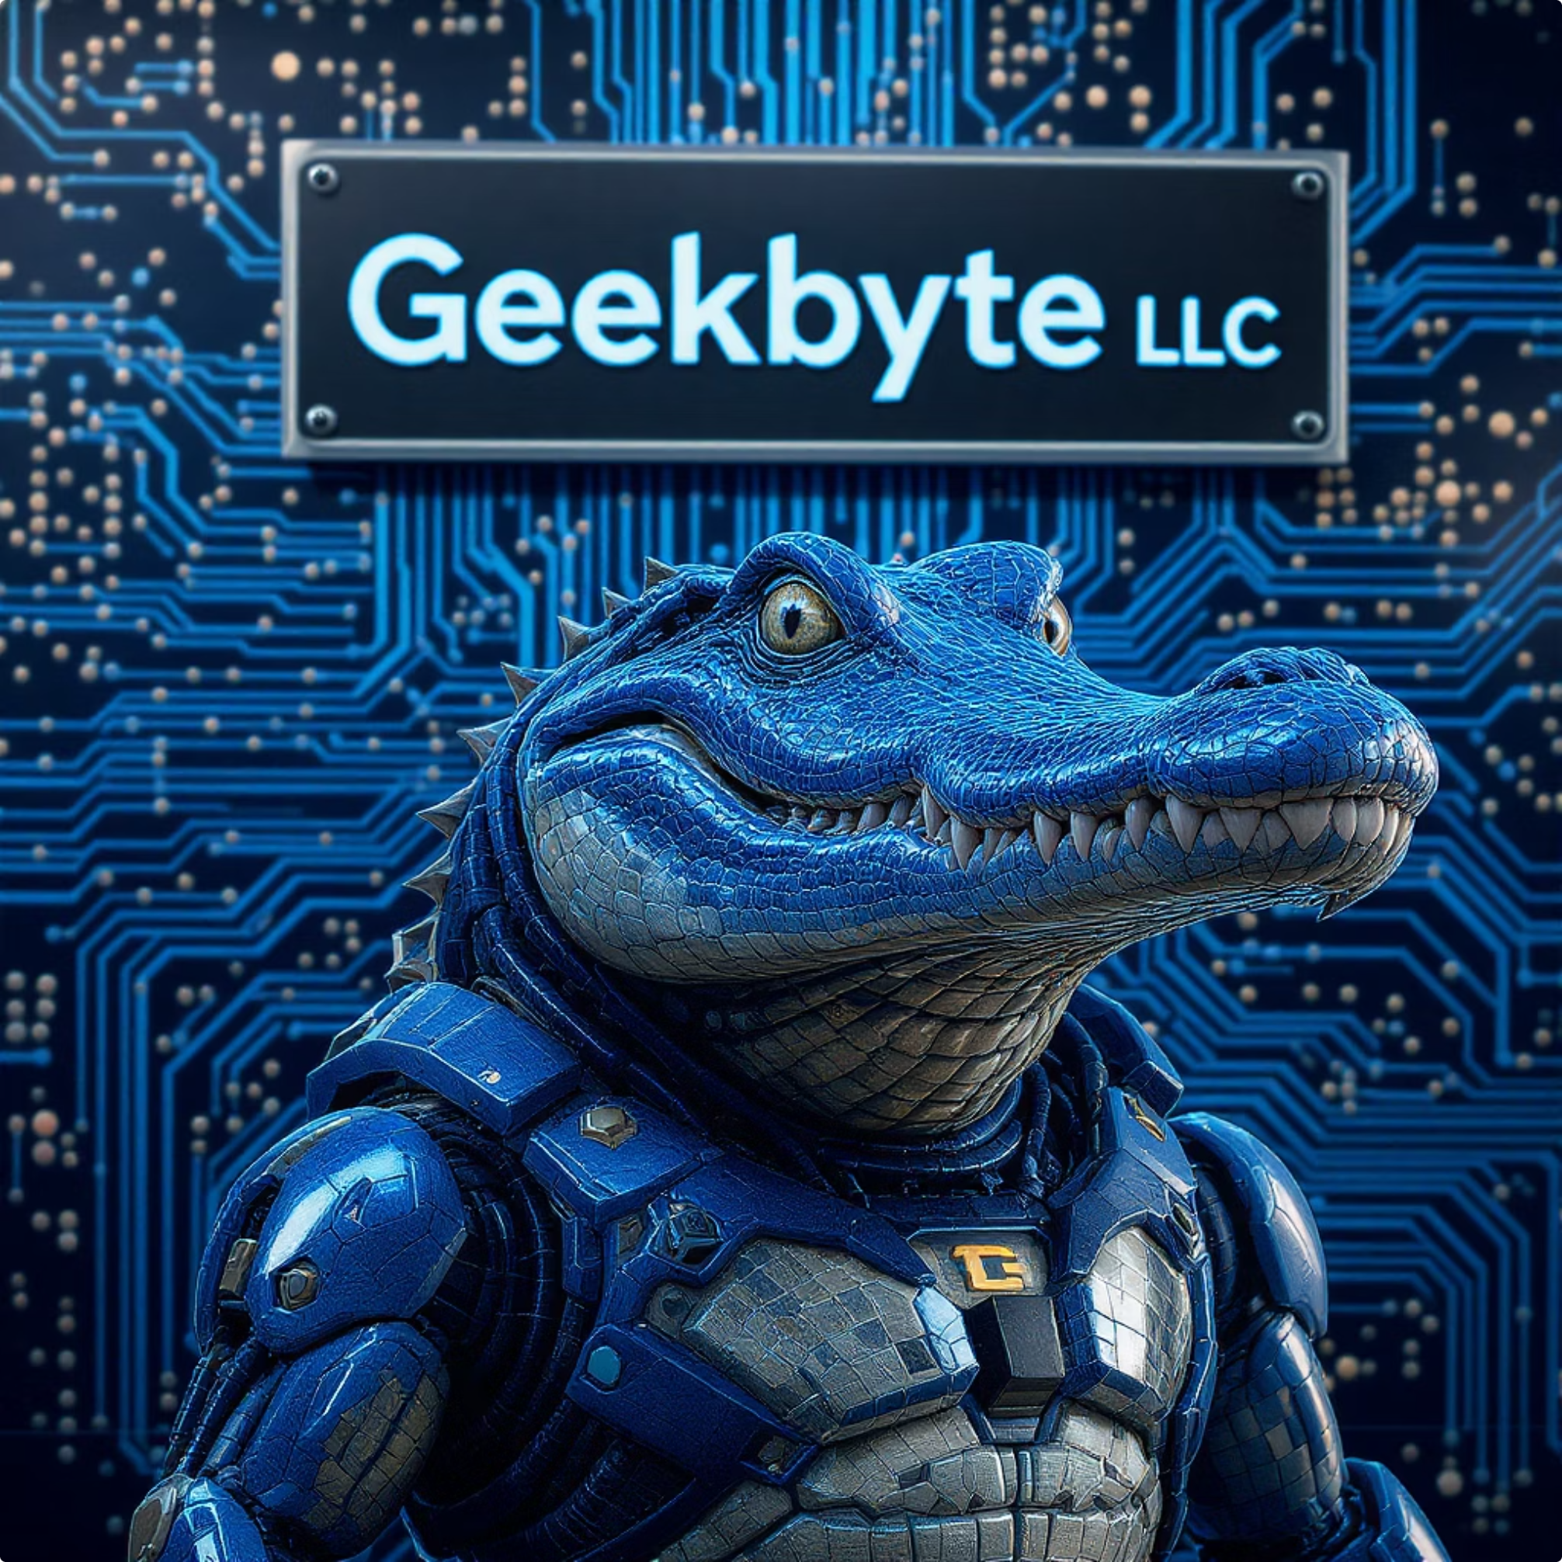
Endeavor Post Close Recommendations
Presented by Geekbyte LLC
July 25, 2025

Slide 2



Executive Summary: Key Findings & Recommendations
Our due diligence identifies significant opportunities to strengthen Endeavor's engineering capabilities, refine product development processes, and optimize technical architecture to support aggressive growth. Strategic hires, process improvements, and balanced technical debt remediation are critical for efficient scaling. Furthermore, it is evident that achieving these ambitious goals will require focused guidance and mentorship for the current leadership team.
Talent & Leadership
Process & Quality
Product Strategy / Execution
Existing leadership gaps and diffused responsibilities across multiple roles impede scalability. Prioritizing the recruitment of an experienced engineering leader and dedicated PM/QA roles is crucial.
Inconsistent Scrum methodologies and reliance on manual QA hinder efficient delivery. Implementing robust, automated QA and market-driven product management is essential.
The architectural rewrite of modules is 20% complete, with licensing issues identified. A balanced approach is needed to progress the rewrite while developing new modules and addressing emerging AI/BI requirements.

Slide 3



Challenges Identified
Here are the key challenges identified across Engineering, Product, and Strategy that need to be addressed to meet the investment thesis.
Engineering / Product Leadership
Product Development / Management Process
Product Strategy / Execution
The absence of cohesive BI/Reporting and AI strategies limits market appeal and agility. An undefined balance between architectural rewrite, technical debt remediation, and new product development impedes overall progress. Furthermore, there's low internal expertise in M&A strategy and integration.
Existing leadership gaps, particularly in Product Management, significantly impede growth. The current Engineering leader's role requires careful transition planning to align with future growth phases, while retaining key talent like the Lead Architect is crucial for stability.
Inconsistent Scrum methodologies and the absence of a defined Product Management process hinder efficient development. The lack of automated QA testing severely impacts sustained velocity and field quality, making robust test suites essential for growth.

Slide 4



Engineering / Product Leadership
Challenges Identified
Recommendations
Execution Plan
Current Engineering leader's fit for next growth phase, requiring careful transition due to positive standing with staff.
Aggressively recruit for an executive-level Product Management position (Sr Dir/VP with CPO growth potential).
Open a VP PM position with executive recruiter ($200k + equity and growth to CPO).
Offer Chris Reichard a 6-month stay bonus for adaptation or exit; retention includes equity share.
Absence of Product Management leadership impeding growth goals.
Provide Board-level oversight to R&D and Product Management leaders.
Offer Brian Webb a twelve-month stay bonus and ISO program participation for continued contributions.
Uncertainty regarding Brian Webb (Lead Architect)'s affinity for current management and equity status; crucial for retention.
Implement mentorship from a senior resource to address organizational deficiencies and drive execution.
Engage an independent board member to work with Ryan and Chris on organizational structure and goals, providing direct oversight and a temporary transition option if needed.
Establish a safety net for current engineering leadership during the transition and hiring of a long-term replacement.
Design processes to scale with M&A.

Slide 5



Product Development / Product Management Process
Challenges Identified
Recommendations
Execution Plan
Product Development process needs alignment with industry standard Scrum process.
New hire VP Product Management being implementing Pragmatic Marketing Framework with training and execution.
New hire VP PM sends direct report(s) for Pragmatic Marketing Framework training for PM/PO track. ($X)
Product Management Process is non-existent and will impede growth goals.
Agile mentoring consultant put in place to work with the team on scrum process, roles and execution in tandem with Pragmatic Marketing.
Hire Agile consultant to work with the team for 3 months to galvanize the process ($X)
QA organization is minimal and has no automated tests. It will not be possible to achieve velocity and have acceptable field quality without automated test suites.
New QA Lead and Outsourced Resources: ($X)
Identify a current or new hire lead in development (not Brian Webb) to take over the Scrum Master role and learn from the Agile consultant.
Implement robust QA processes and improved visibility into quality metrics.
Automated regression test suite and automation done in line with Scrum cadence.
Hire a new QA lead tasked with spinning up an automation / QA team. The lead will be tasked with creating a full automated regression test suite and then driving the team to automate tests as part of the Scrum process.
Brian Webb to investigate AI code review and code generation tools with Independent board member to build relationship. ($X for tools)
Implement AI code review and code generation tools into the process post Scrum and Pragmatic roll out.
Design processes to scale with M&A.

Slide 6



Product Strategy / Execution
Challenges Identified
Key Recommendations
Execution Plan
Lack of a cohesive BI / Reporting strategy to appeal to upmarket customers.
VP Product Management to work with the Independent Board member on BI / Reporting Strategy, considering customer/market needs, expandability, cost, and partnership opportunities.
VP Product Management to collaborate with Market Research, CAB, and Sales to define BI / Reporting and AI needs, vision, expansion opportunities, and fit with corporate growth. Identify buy/partner opportunities and estimate customization costs. Present vision to the board for investment direction.
Lack of a cohesive AI strategy for fast-moving software market conditions.
Need for agreement on balancing rewrite / technical debt and new product development.
VP Product Management to work with the Independent Board member on AI Strategy, covering customer/market needs, expandability, cost, and partnership opportunities.
Low bandwidth and expertise in M&A strategy and integration execution.
Agree on a roadmap and a balanced percentage of effort between technical debt / new development, reporting on KPIs that show compliance and results.
VP Engineering, VP Product Management, and Independent Board member to collaborate on roadmap balance for new offerings and technical debt.
Short term: LE to identify "slam dunk" M&A opportunities for early leadership synergy. Long term: VP Product Management to identify buy / partner opportunities that fill gaps in the product vision.
VP Product Management and Independent Board Member to work with LE on market expansion and identifying product gaps.

Slide 7




Independent Board Member:
A Catalyst for Growth
An independent board member offers invaluable, objective expertise and oversight, critical for Endeavor's upcoming phase of rapid scaling and operational refinement. Their guidance will be key to strengthening engineering capabilities, streamlining product development, and optimizing strategic market positioning.
Strengthened Leadership & Governance
Optimized Development & Quality Processes
Strategic Product & Technical Guidance
Actively help bridge existing leadership gaps, particularly by guiding the recruitment of an experienced engineering leader and dedicated PM/QA roles. The board member will provide essential mentorship for the current leadership team and ensure robust, independent oversight for enhanced accountability and growth.
Drive specific improvements in product development, including formalizing inconsistent Scrum methodologies and establishing robust, automated QA protocols. This will ensure efficient delivery, higher product quality, and reduced reliance on manual testing.
Provide a clear vision for product strategy and execution, specifically addressing the 20% complete architectural rewrite and navigating licensing issues. This includes balancing technical debt remediation with the development of new modules and integrating emerging AI/BI requirements for long-term market advantage.

Slide 8






Independent Board Member Involvement
Strategic Oversight & Guidance
Process & Structure Development
BI & AI Strategy Collaboration
Provide crucial Board-level oversight to R&D and Product Management leadership, ensuring alignment with overarching company goals and market demands.
Directly assist in establishing robust organizational structures and defining key product development processes post-close, including the implementation of Scrum and Pragmatic Marketing frameworks. Design the organization with integrating several M&A targets.
Collaborate with the new VP Product Management to shape cohesive strategies for Business Intelligence and AI, identifying market needs, partnership opportunities, and investment directions.
Product Roadmap & Tech Debt Balance
Risk Mitigation & Transition Support
Mentorship & Relationship Building
Work alongside VP Engineering and VP Product Management to balance the roadmap between new product development and essential tech debt, ensuring sustainable growth and innovation.
Offer a vital safety net in leadership transitions, providing direct insight into challenges and facilitating smooth knowledge transfer for continued operational stability.
Serve as a senior mentor, fostering critical relationships, like with Brian Webb on AI tools, and driving the execution of key growth initiatives across the product and engineering teams.

Slide 9


Proposed Strategic Support Dual Role
Independent Board Member
Independent Consultant
Commitment: Estimated 10 hours/month (annual renewable contract).
Commitment: Up to 30 hours/month for 3 months additional (plus remainder of 10 monthy). Depends on need to fill any vacancy temporarily.
Compensation: Mix commensurate with position at LE Portco board
Role: Provides high-level strategic oversight, mentorship, and governance for R&D and Product Management. Board visibility of acquisition product / technical progress . Technical leadership guidance and risk reduction. Non-competitive role to current leadership.
Rate: $400 per hour.
Total Cost: Up to $72,000 (6 months x 30 hrs/month x $400/hr).
Role: Focuses on aligning product strategy with company goals, optimizing development processes, and guiding key initiatives (BI/AI strategy, tech debt balance, M&A integration). Galvanizes Scrum process with consultant help, provides hands-on training for PM/PO, supports the new QA Lead in implementing robust QA protocols, and assists with product backlog refinement.
Value: Brings objective expertise, strengthens leadership, mitigates risks during rapid scaling and transitions. Offers M&A Technical Due Diligence and integration advice.
Value: Accelerates process adoption, boosts team efficiency, establishes foundational practices for scalable growth, and reduces operational risks.

Slide 10




Interim CTO / Advisor Role
Complete and Verify Remediation Work from Close
Strategic Staffing
Product Operations and Strategic Roadmap Prioritization
Commitment
Work with the team to QA and publish changes to the production environment.
Drive hiring of VP Product Management.
Review priorities and resource allocation for technical debt (rewrite) and new product development.
Up to 60 hours/month for 5 months. Depends on the need to fill any vacancy temporarily, hiring timelines, and execution of current staff. Burst capacity is available if approved.
Drive hiring of QA lead. Work with QA lead to build a plan for building and maintaining automated test suites and an associated staffing plan.
Re-run scan with FOSSID (at discounted delta rate) and verify that remediation in the codebase was successful.
Work with the new VP PM on the new product roadmap and BI/AI strategy.
Write up final release for legal, confirming that remediation of identified Critical/High items identified at close are complete.
Drive reallocation of the Scrum Master role. Bring in a consultant for short-term training and mentoring of the team.
Work with Brian Webb on AI-focused dev tools strategy. Begin with code review tools and progress to code generation.
Rate: $450 per hour.
Total Cost: Up to $150k. Invoiced bi-weekly with hour allocation report.
Mentoring / coaching of the VP of Engineering. Develop gap analysis and training / growth needs.
Review Product Development process gaps and remediate with an eye for future M&A integration ease.
Bi-weekly check-in with Level Equity on progress/challenges.

Slide 11






Next Steps / Open Items
Discuss Structure of Engagement with Geekbyte for Independent Board Membership.
Research rough implementation costs for execution items
LE Engagement with Endeavor Leadership on remedial needs in Product / Dev

Slide 12


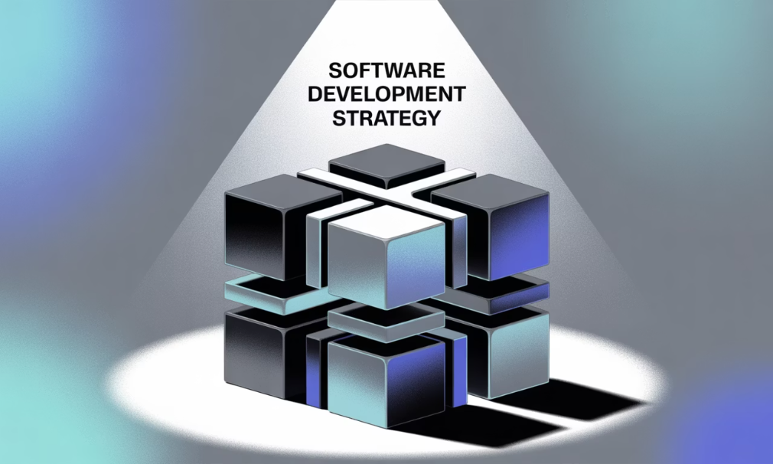
Strategic Recommendations: A Path Forward
Talent & Leadership
Process & Quality
Architecture & Technical Debt
Recruit a new Engineering Leader for long-term growth.
Implement consistent Scrum practices.
Prioritize new module development on the new architecture.
Adopt robust, automated QA processes with external resources.
Incentivize and retain Brian Webb to drive architecture.
Balance rewrite progress with value creation.
Develop market-driven Product Management strategies.
Develop a cohesive BI/Reporting strategy (buy/partner approach).
Establish dedicated roles for Product Management, QA, and Scrum Master.
Remediate open-source licensing issues (pre-close for easy fixes).
These recommendations are from the prior Endeavor due diligence report

